Slide 1
Modernizing a 17th Century Italian-English Dictionary
Wayne Sebbens Software Architect @ Reapit

Slide 2

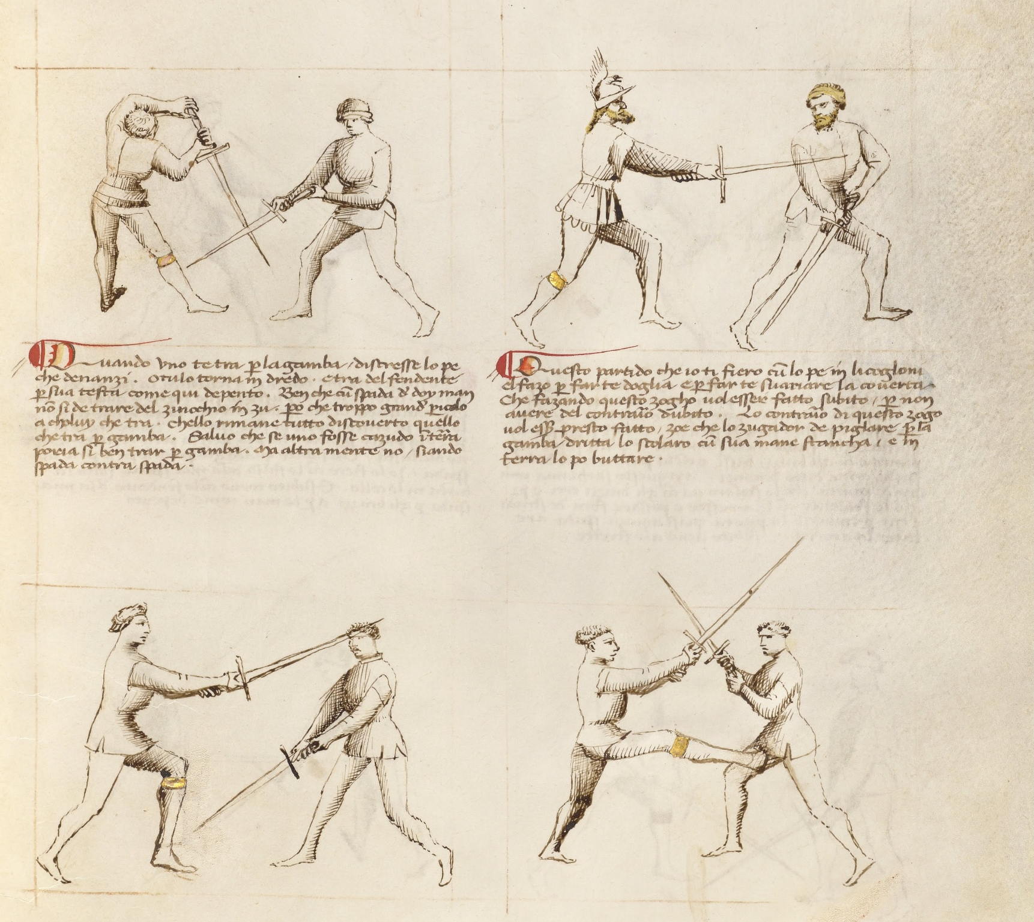


Slide 3
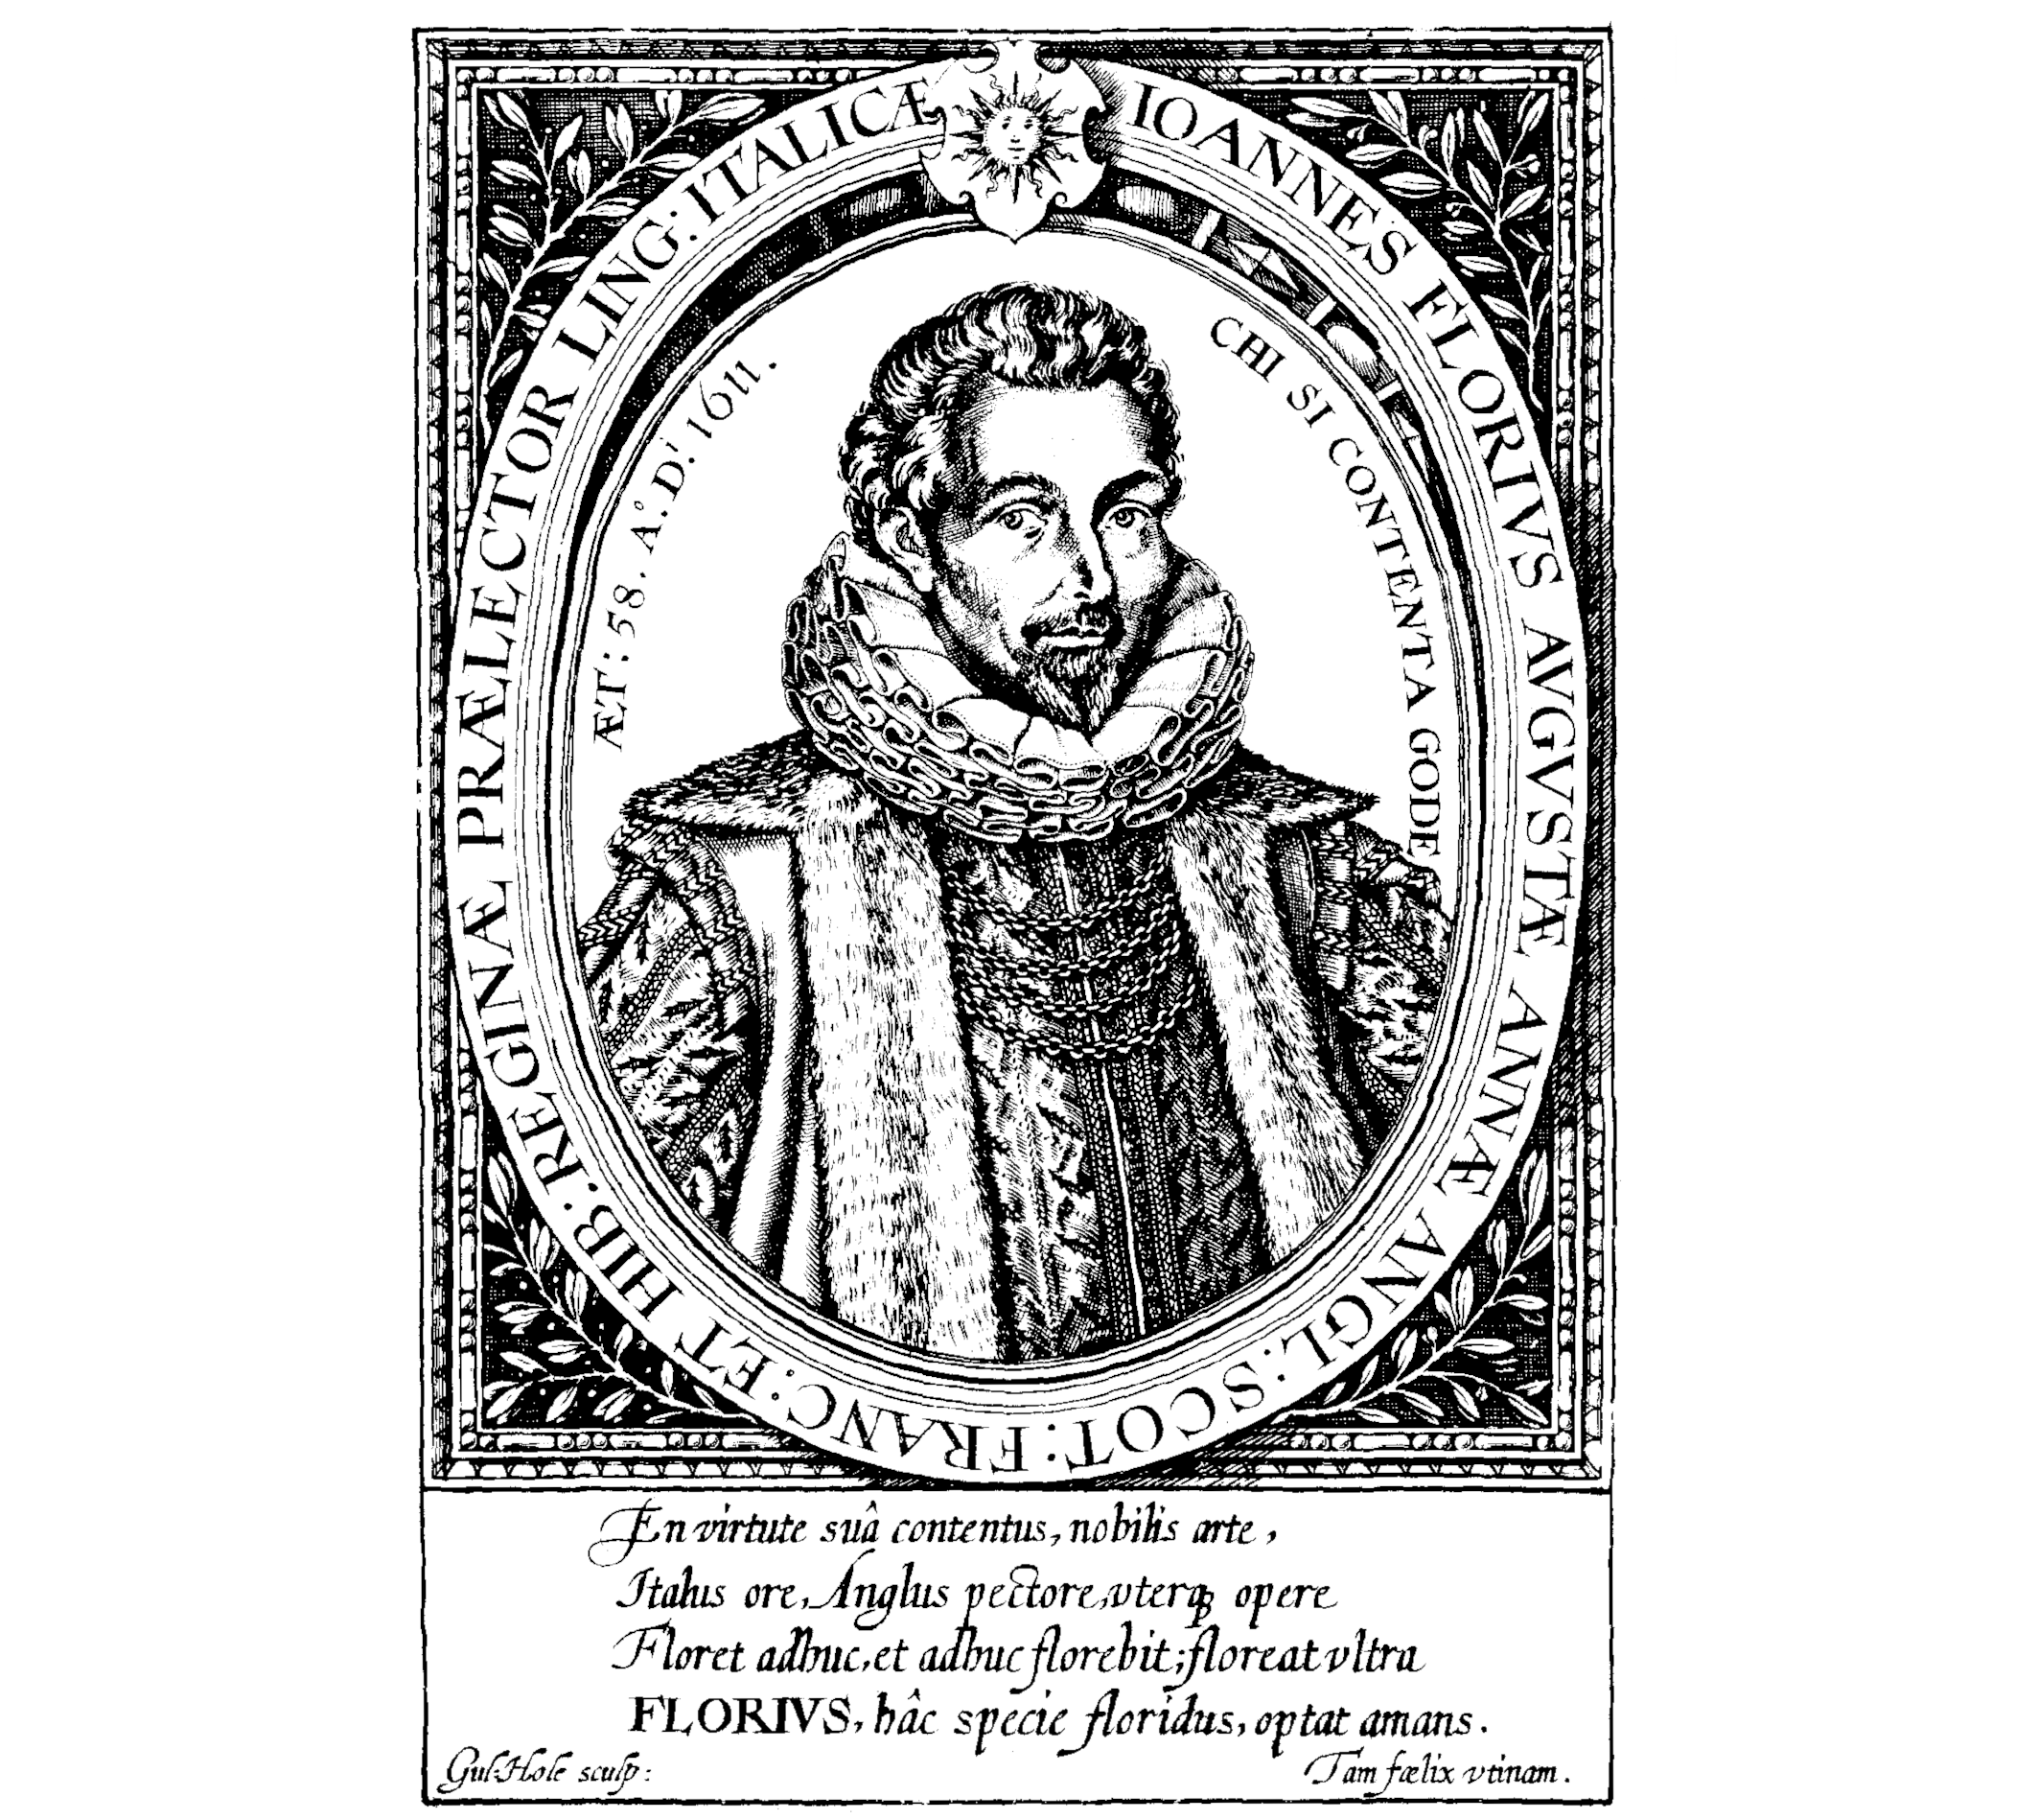
John Florio (1552-1625)
English linguist, lexicographer, and translator
Contributed over 1,100 words to English, e.g.
Judicious
Management
Transcription

Slide 4
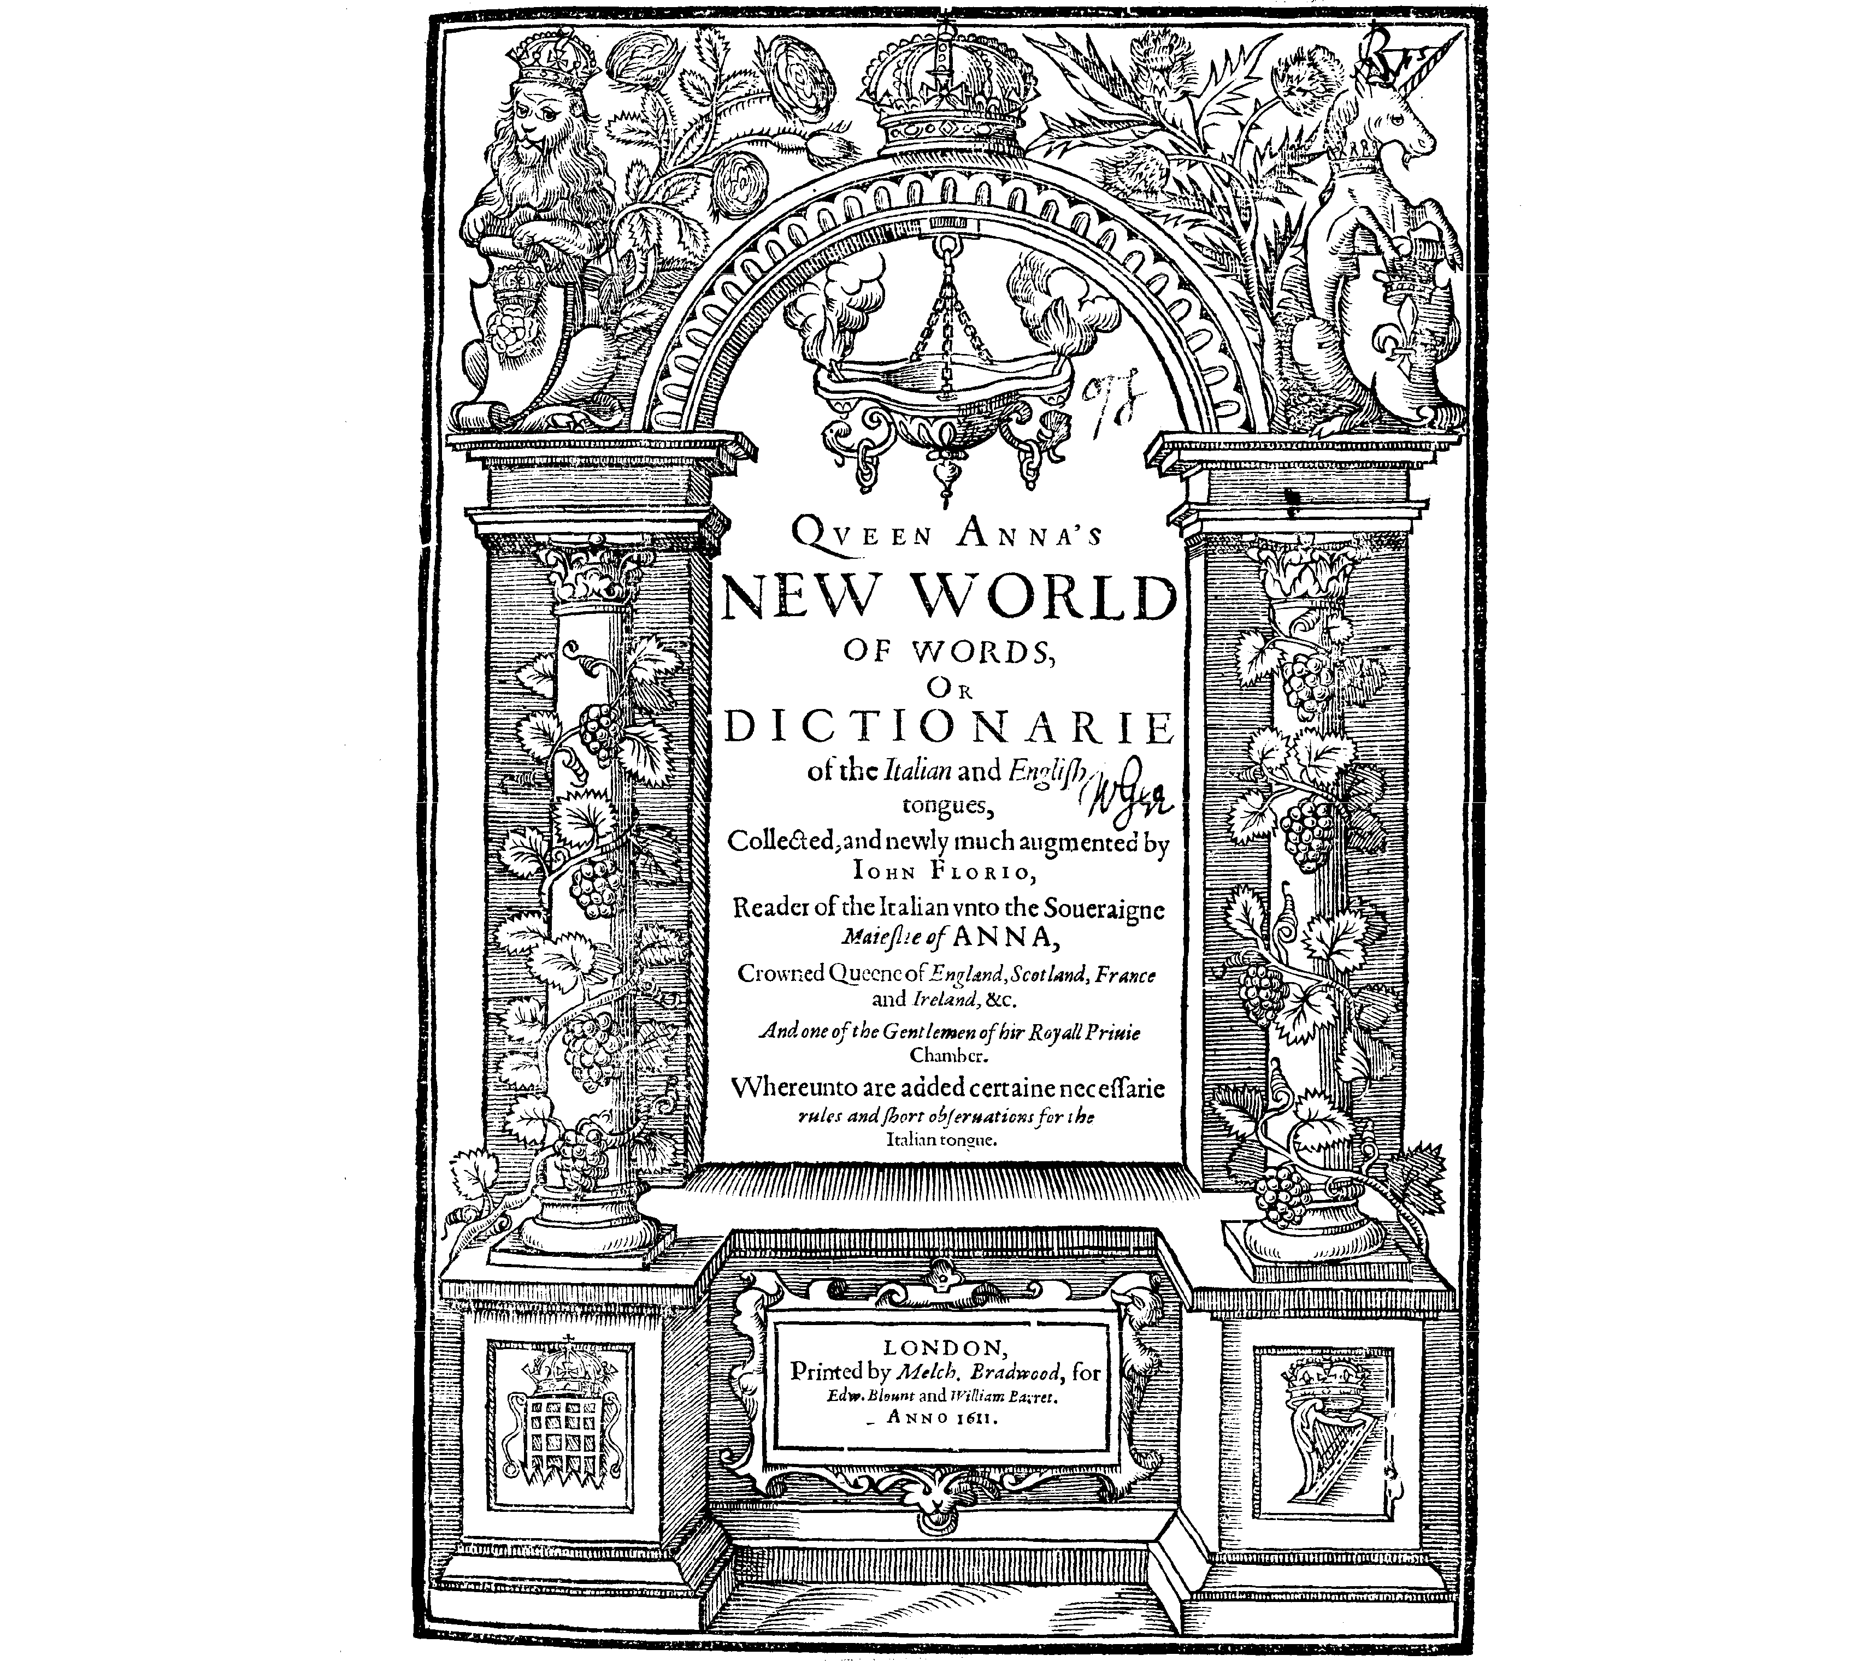
Queen Anna’s New World of Words
Florio’s second Italian-English Dictionary First published in 1611
Contains around 75,000 Renaissance Italian to Early Modern English definitions Scans: https://www.pbm.com/~lindahl/florio/
Transcription: https://www.gutenberg.org/ebooks/56200

Slide 5
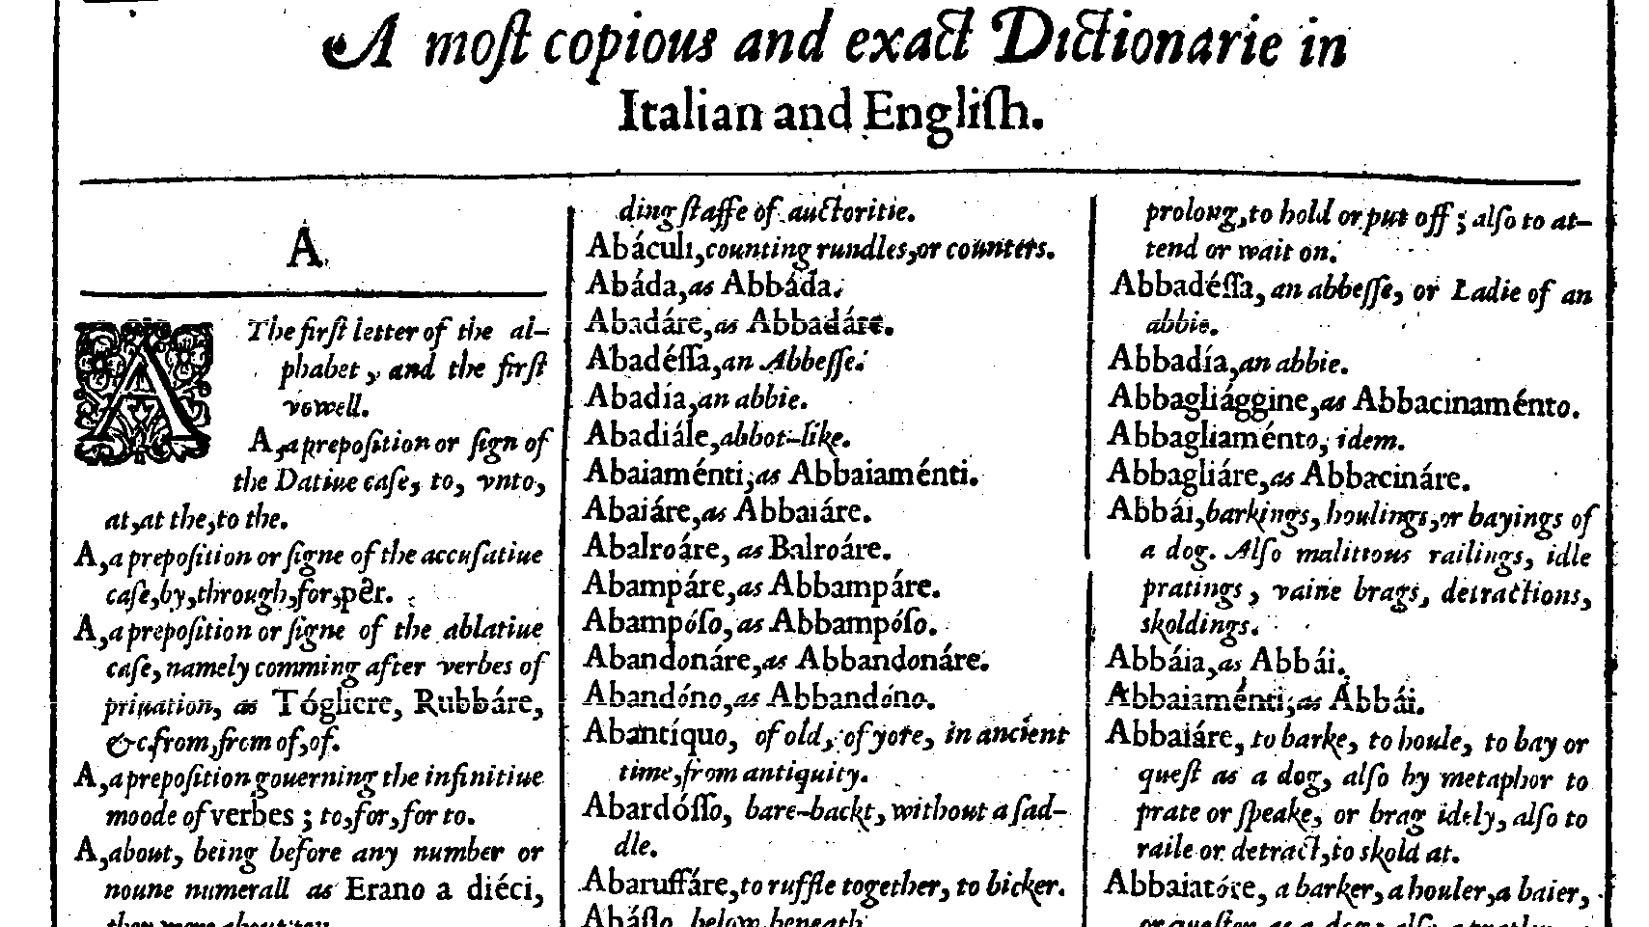

Slide 6
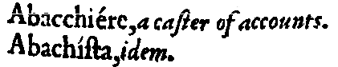
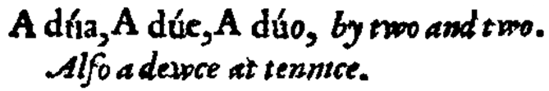
Quirks
idem
Multiple spellings
the same (from Latin/Middle English)

Slide 7
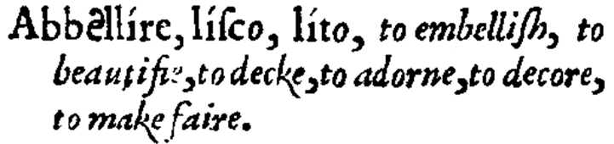
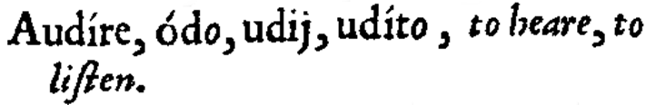
Quirks
Conjugates
Shared lexeme
No shared lexeme
First lemma spelled in full, then only the stems
Each lemma spelled in full

Slide 8
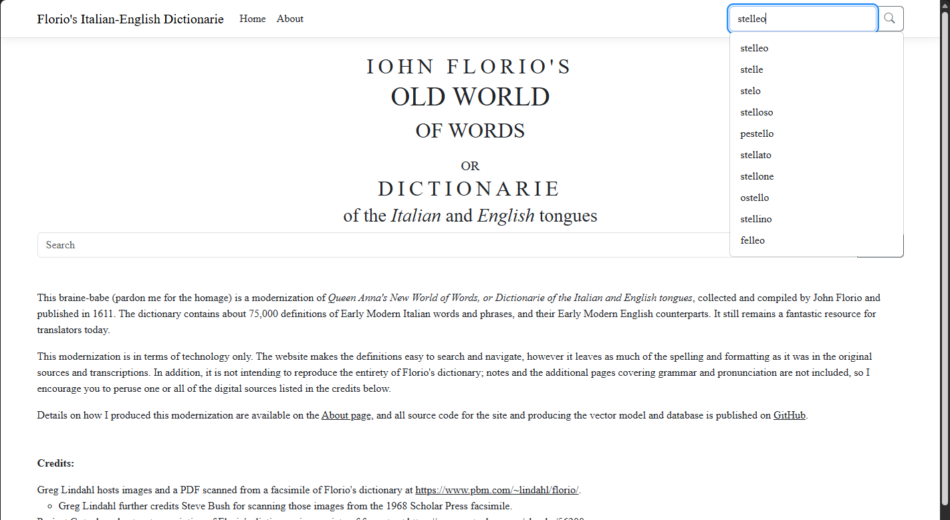

Slide 10
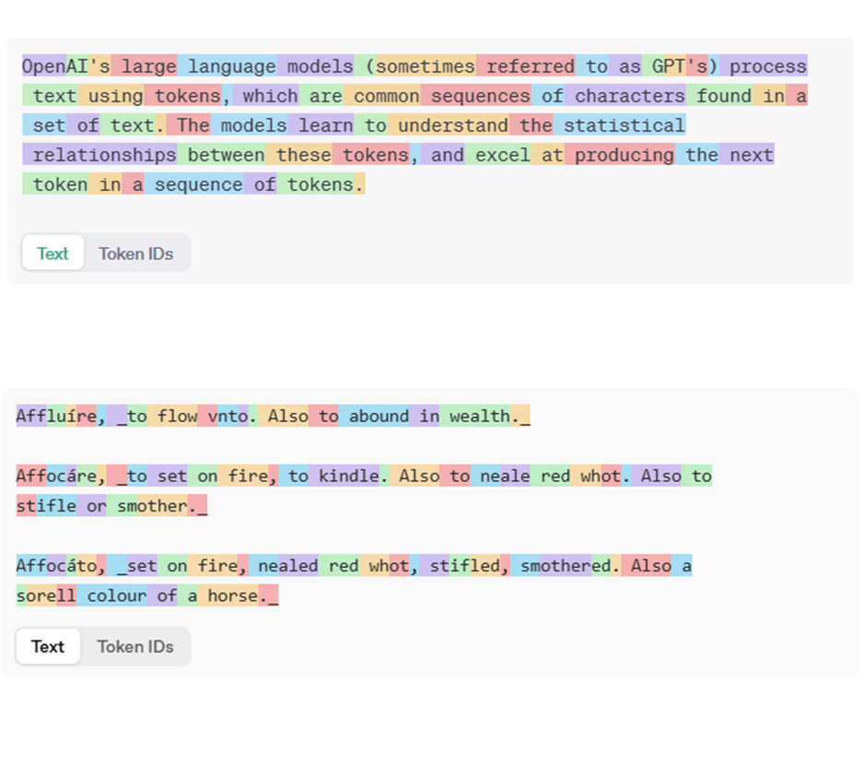
Vector Embeddings
Vector similarity search is designed for fuzziness.
Target my embeddings on the Italian words, not the definition.
Search should allow for spelling differences.

Slide 11
Custom embedding model

Slide 12
Custom embedding model

Slide 13



.NET 10 and beyond
What’s next for my project?
EF Core 10 Vector Search
Semantic Kernel
More Dictionaries
EF Core 10 adds vector search on embeddings in the new vector data type. Also adds hybrid search on Azure Cosmos DB for NoSQL.
Semantic Kernel Vector Store connectors support embedding generators — including Microsoft.Extensions.AI. Automatically generate embeddings during both upsert and search operations.
Support more languages by adding more dictionaries, such as Randle Cotgrave’s “A Dictionarie of the French and English Tongues”.

Slide 14
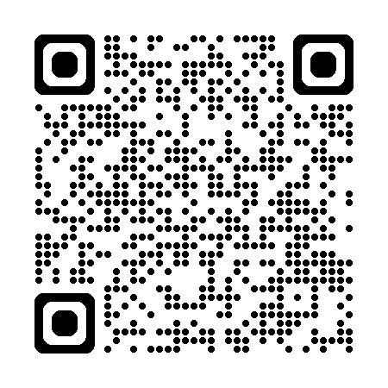
Thank you!
https://github.com/Sebbs128/florio-dotnetconf-links

